Slide 1



There is a clinical benefit of sonothrombolysis
Ž. Krsmanović ,T. Lepić, D. Veljančić, S. Čolić, B. Labović, R. Raičević.
Clinic of neurology Military Medical Academy
Belgrade Serbia 10.2021.

Slide 2
. 2017 Feb;48(2):
Safety and efficacy of sonothrombolysis for acute ischaemic stroke: a multicentre, double-blind, phase 3, randomised controlled trial CLOTBUST-ER Trial Investigators*
Lancet Neurol 2019; 18: 338–47
NOR-SASS (Norwegian Sonothrombolysis in Acute Stroke Study)
Randomized Controlled Contrast-Enhanced Sonothrombolysis in an Unselected Acute Ischemic Stroke Population
Aliona Nacu Stroke 2017 Feb;48(2):

Slide 3
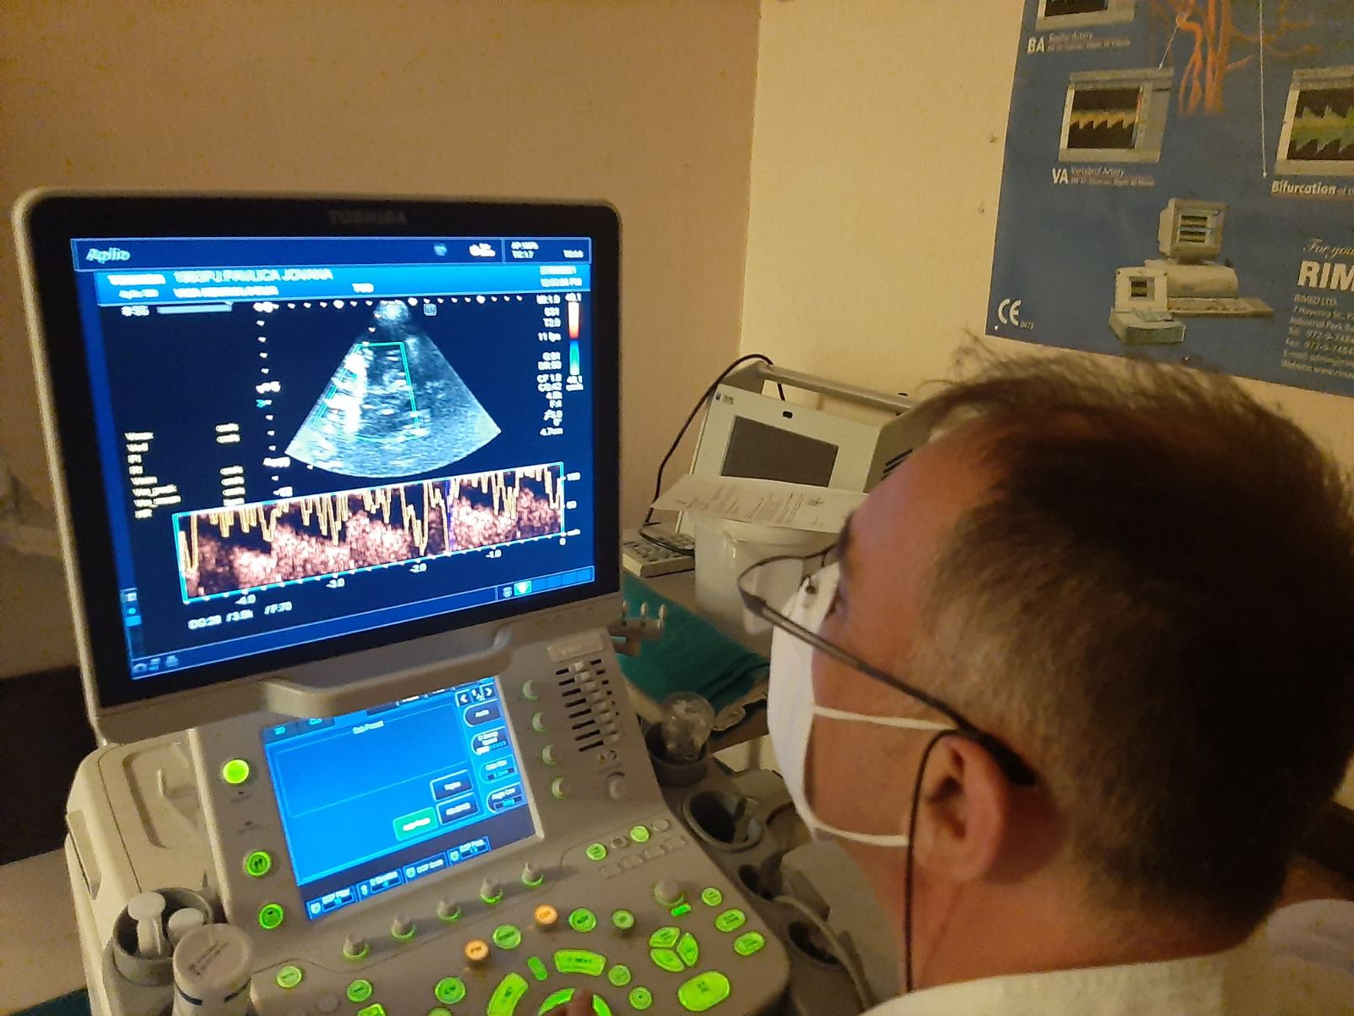
Methods:
The patients who fulfilled criteria were treated with sonothrombolysis or intravenous thrombolysis. The efficacy was being estimated based on the Modified Rankin Scale (mRS) three months after the stroke. A favourable outcome - the mRS values ranging from 0-2. Safety was estimated based on the existence of symptomatic intracerebral hemorrhage. CT of the brain with CT angiography was performed up to 48 hours following the therapy. If the hemorrhage that could cause the increase in the NIHSS score by ≥4, existed, it was considered to be symptomatic.

Slide 4
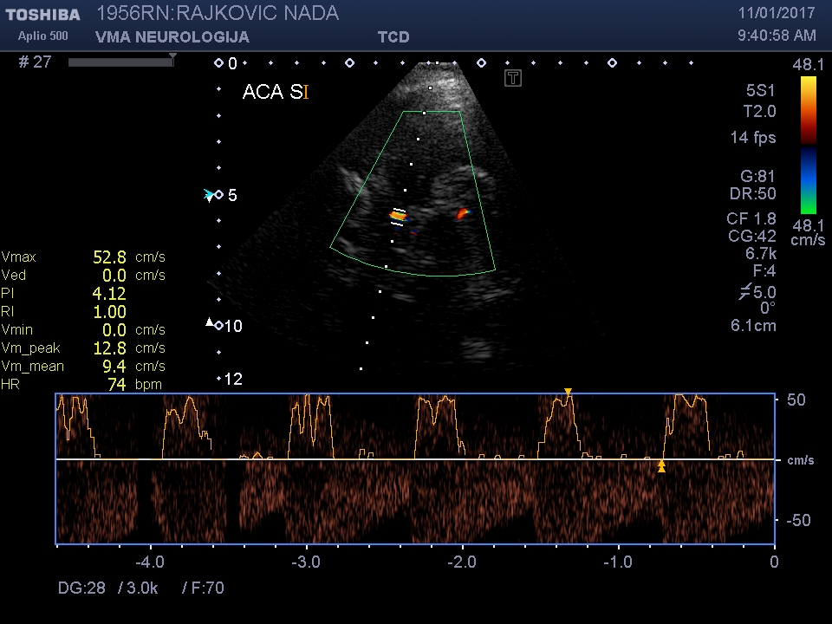

Slide 5
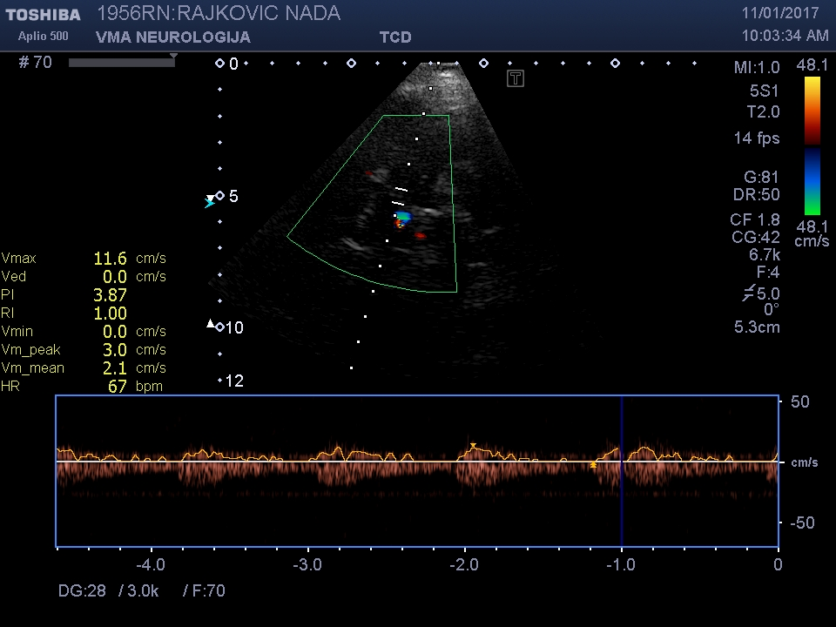

Slide 6
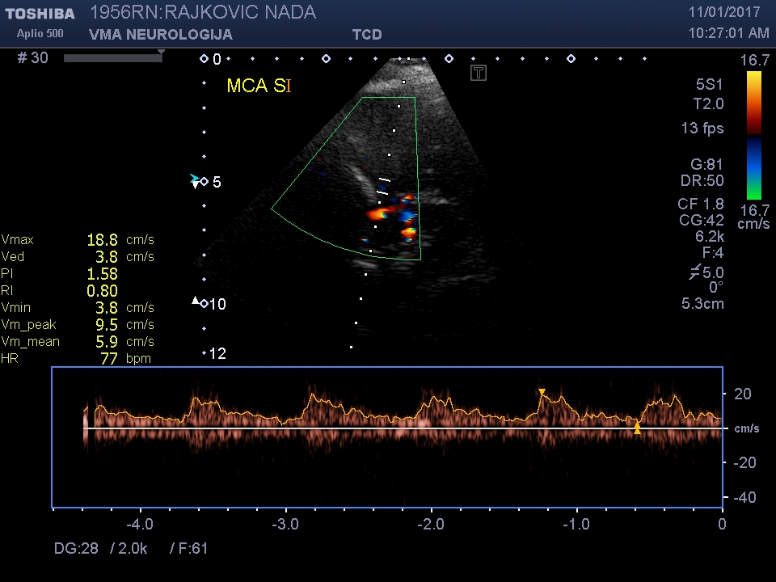

Slide 7
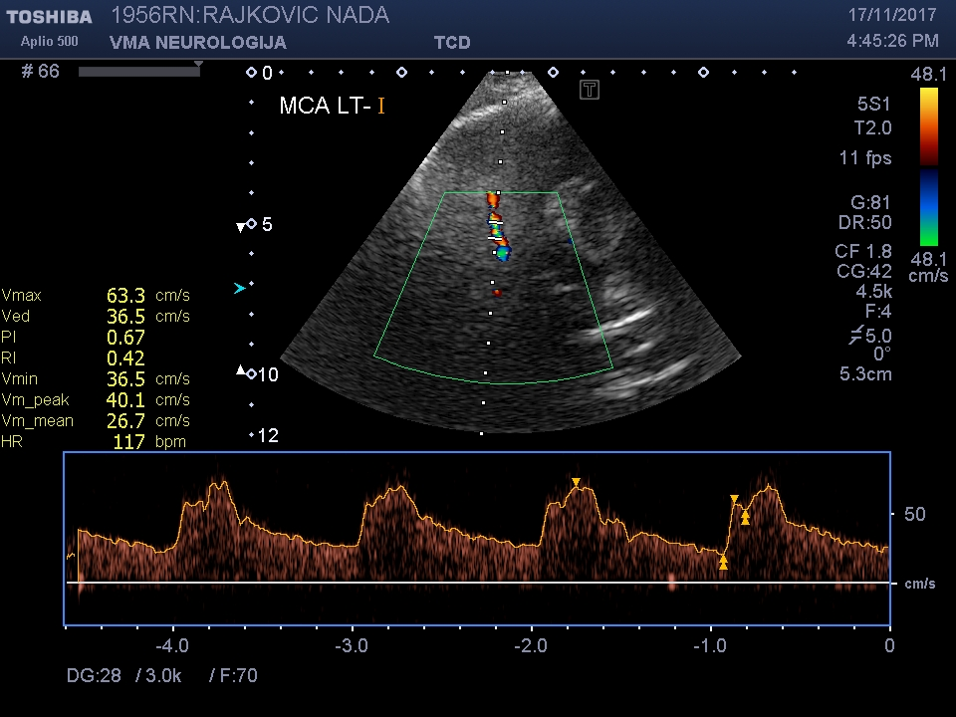

Slide 8
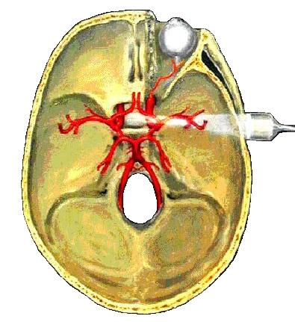
Results:
There were 26 patients who were treated with sonothrombolysis and 84 patients who were treated with thrombolysis. The age ( 66,3 vs 68), initial neurological finding (NIHSS 14,1 vs NIHSS 14,5), did not show statistical differences. The patients who were treated with sonothrombolysis were statistically more often functionally independent relative to the patients treated with thrombolysis (61,5 % vs 39,2% ; OR 2,47; 95% CI: 1.0020 to 6.1022; P = 0.0495).
There were no statistically significant differences related to symptomatic intracerebral hemorrhage between the examined groups ( 8% vs 7.5 %; P = 0.925).

Slide 9
Conclusion:
Sonothrombolysis is considered to be safe and it increases considerably the percentage of patients that are functionally independent three months following the stroke compared to the patients that were treated only with intravenous thrombolysis.

